Slide 1

SoccArt: AI Football Analytics

Slide 2
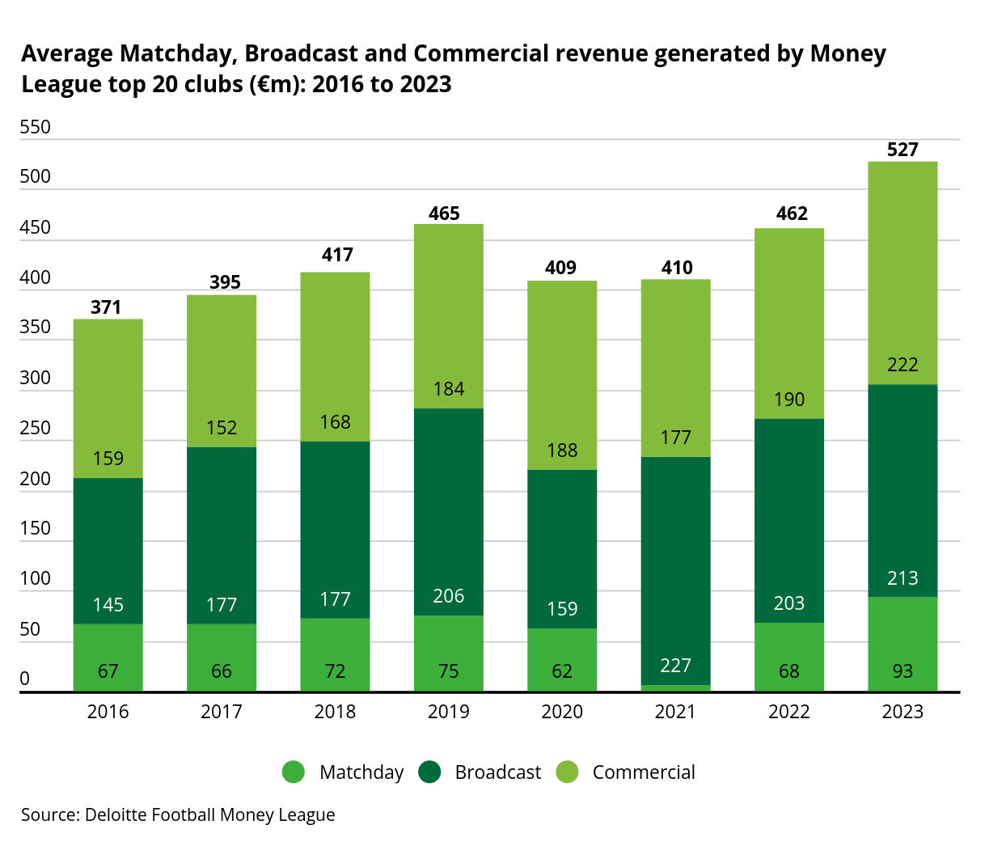

Slide 3

Why Vision-Based Analytics?

Slide 4
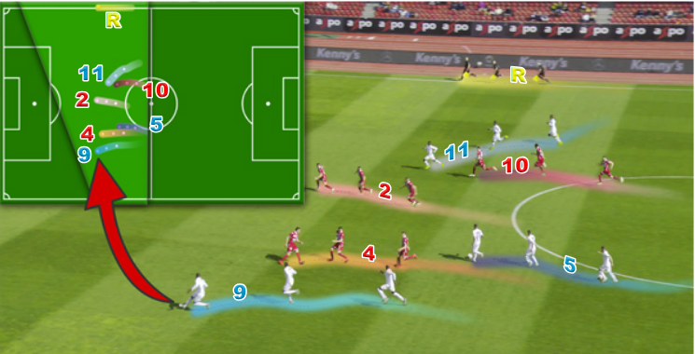
What we are doing
End-to-End Game State Reconstruction
Given a footage of a professional football game, we create a minimap of the players in the camera's view.
We can track players, identify jersey numbers, classify into teams and even suggest tactical advice!

Slide 5
Dataset for Training
SoccerNet (https://www.soccer-net.org/)
SoccerNet is a large-scale dataset for soccer video understanding. It has evolved over the years to include various tasks such as action spotting, camera calibration, player re-identification and tracking. It is composed of 550 complete broadcast soccer games and 12 single camera games taken from the major European leagues. SoccerNet is not only dataset, but also yearly challenges where the best teams compete at the international level.

Slide 6

Literature Review/State of the Art.
The initial challenge and dataset was published by SoccerNet

Slide 7
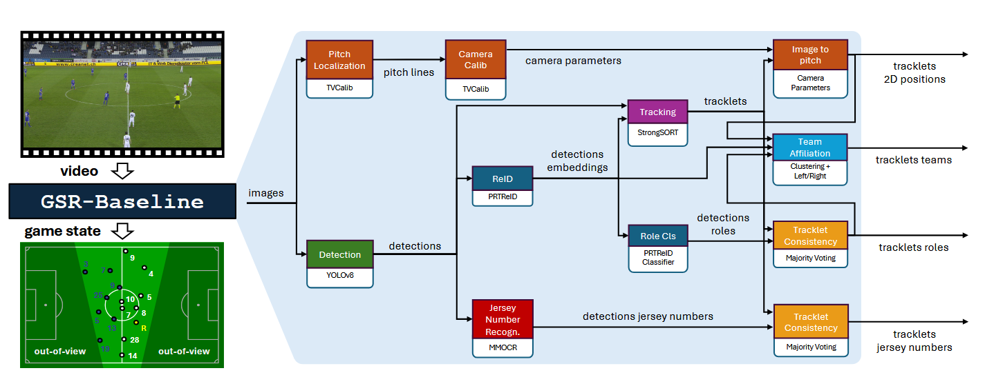
The existing baseline

Slide 8
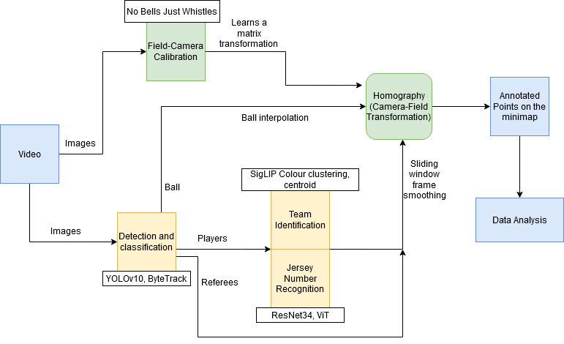
Our Framework

Slide 9
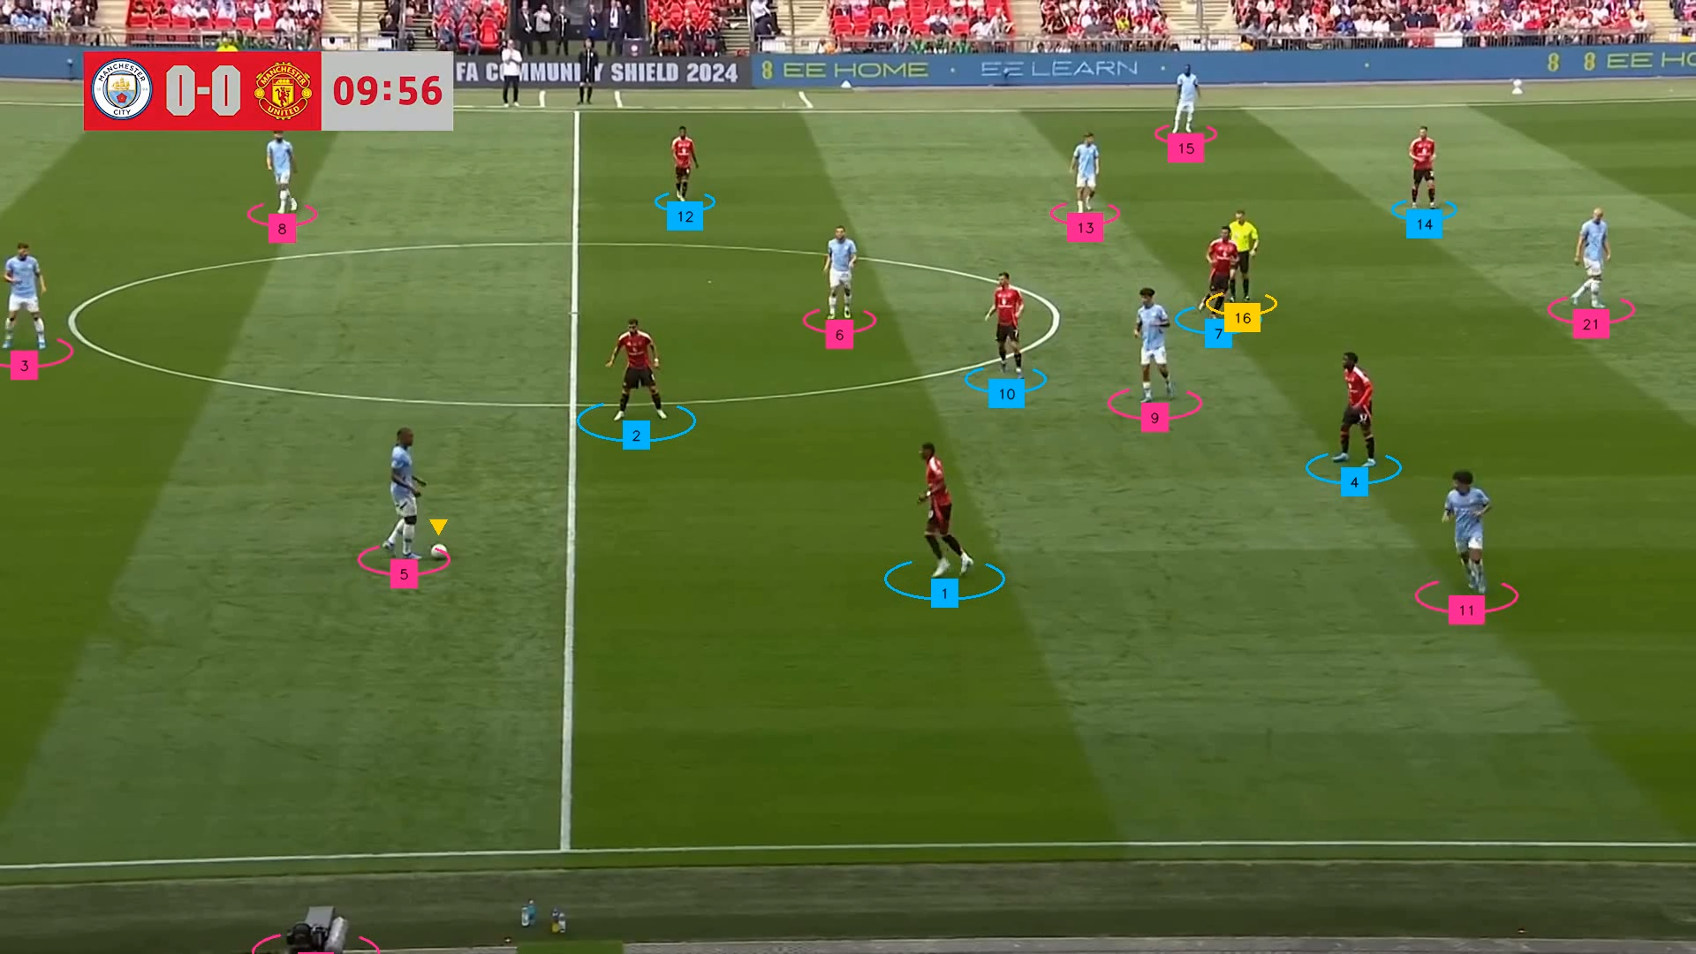
Player Tracking
We used the YOLOv10 model, finetuned on the players, referees and balls from the SoccerNet dataset to allow accurate detection.
We used ByteTrack for multiple object tracking.

Slide 10
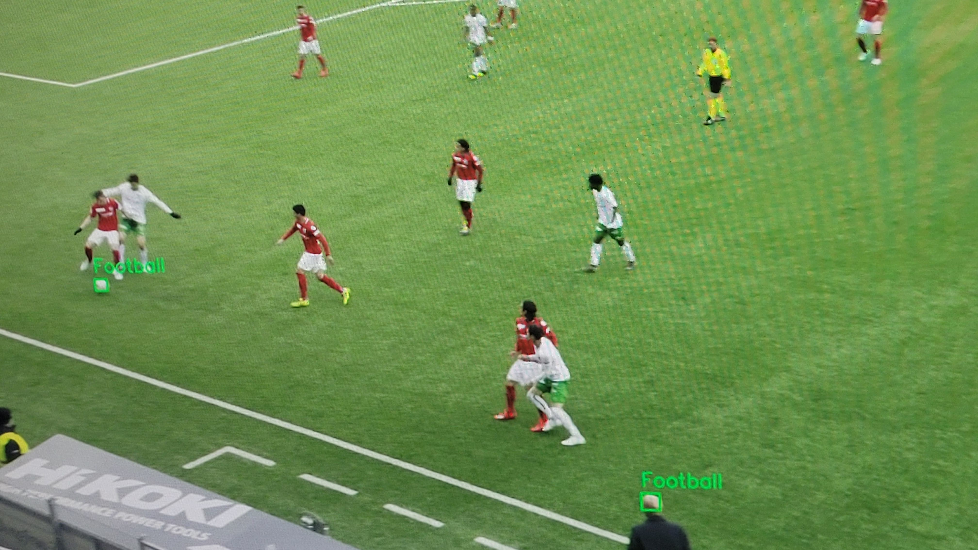
Ball Tracking
Although the model was able to detect players and referees, it failed at detecting the ball properly.
See the Image.
So, we finetuned another YoloV10 using only the ball data.

Slide 11
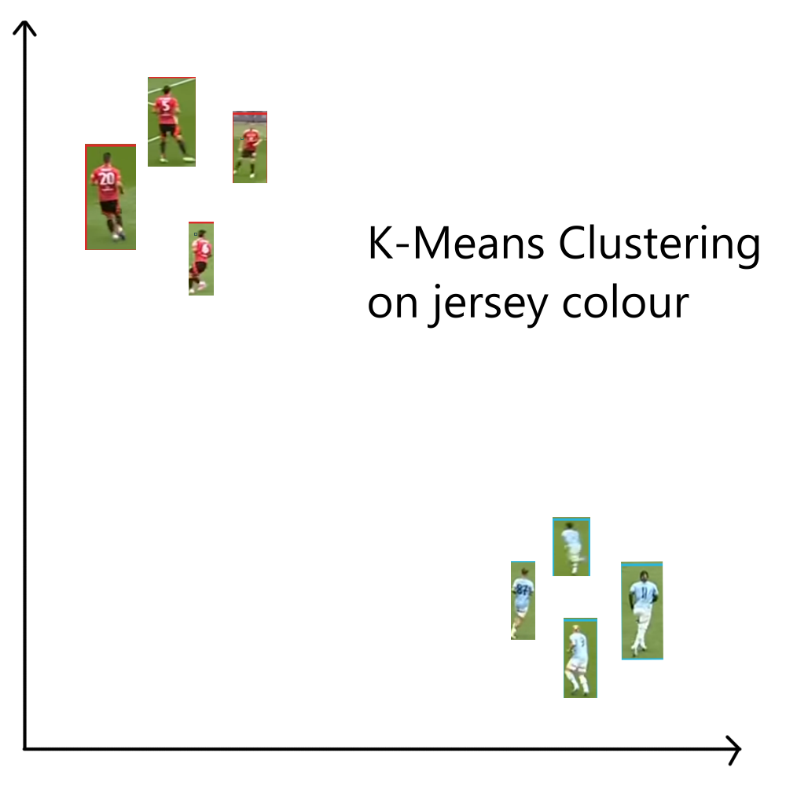
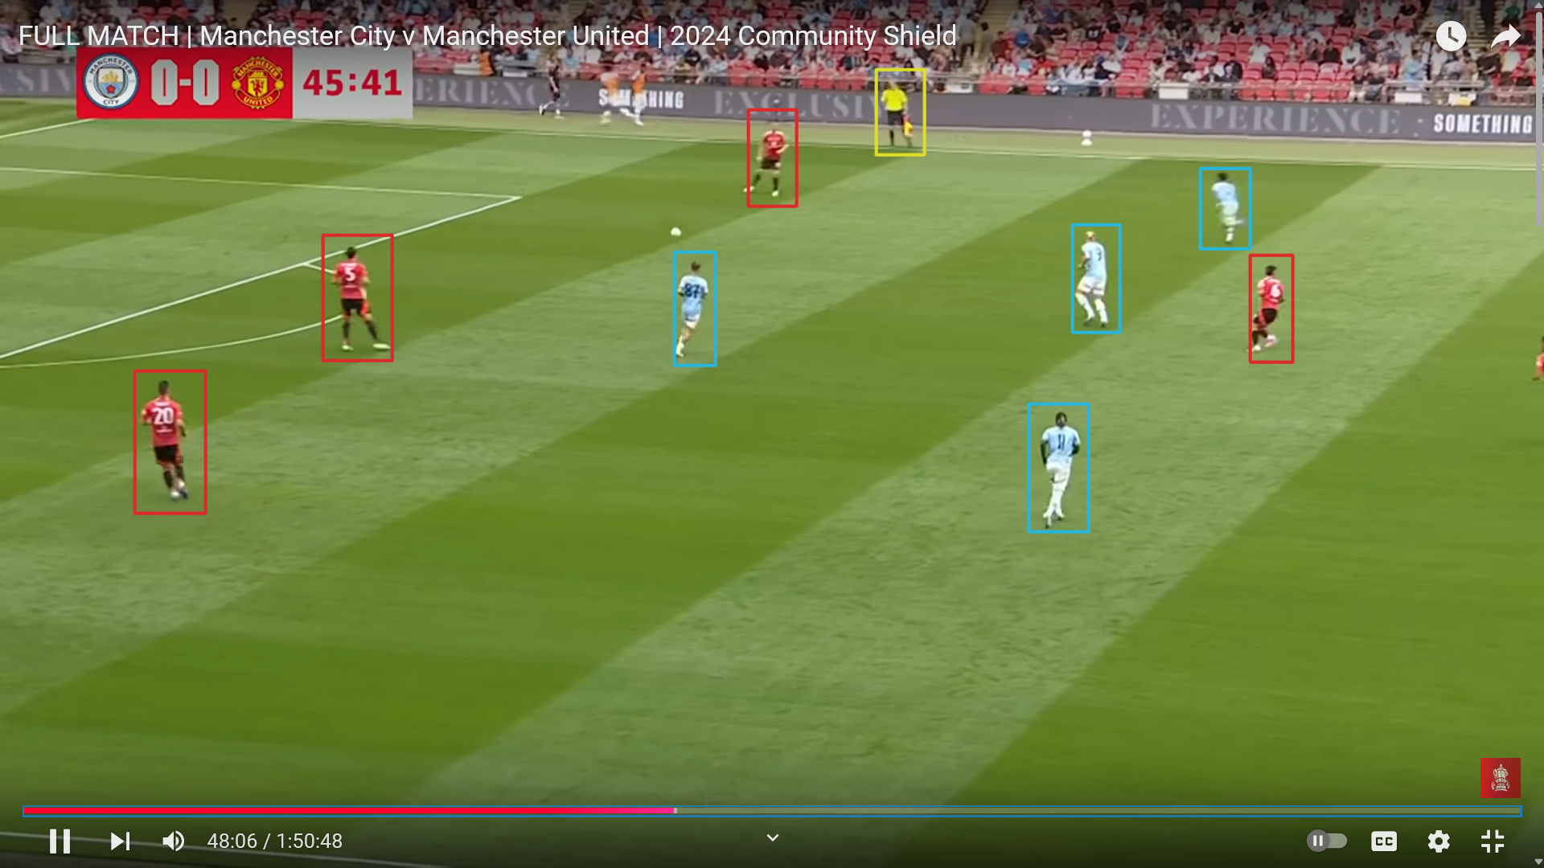
Team Identification (SigLIP, K-means on colours)

Slide 12
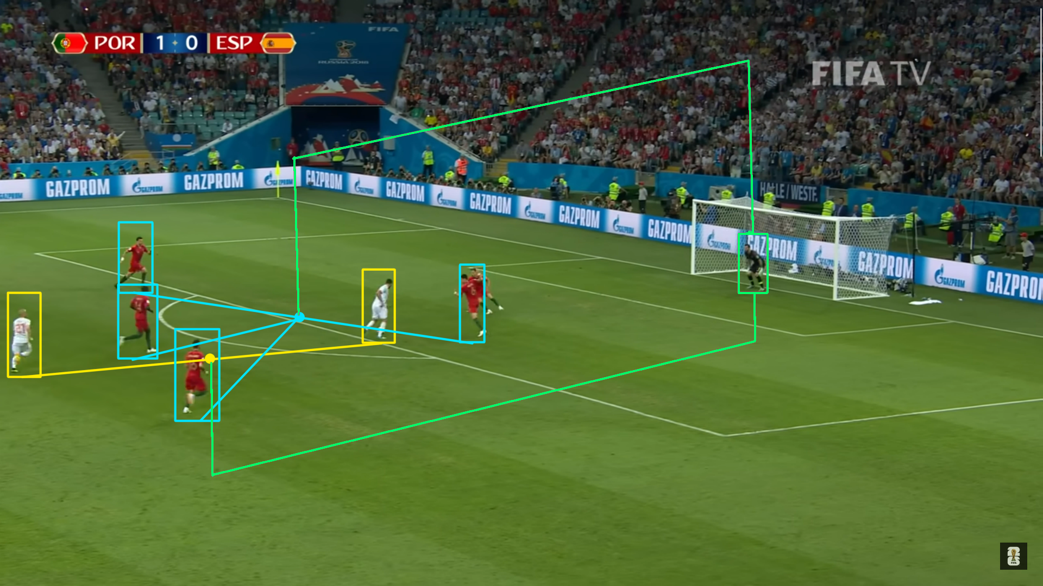
Goalkeeper Team Identification
Goalkeeper's team assigned by calculating his distance from the centroid of the players of both teams

Slide 13
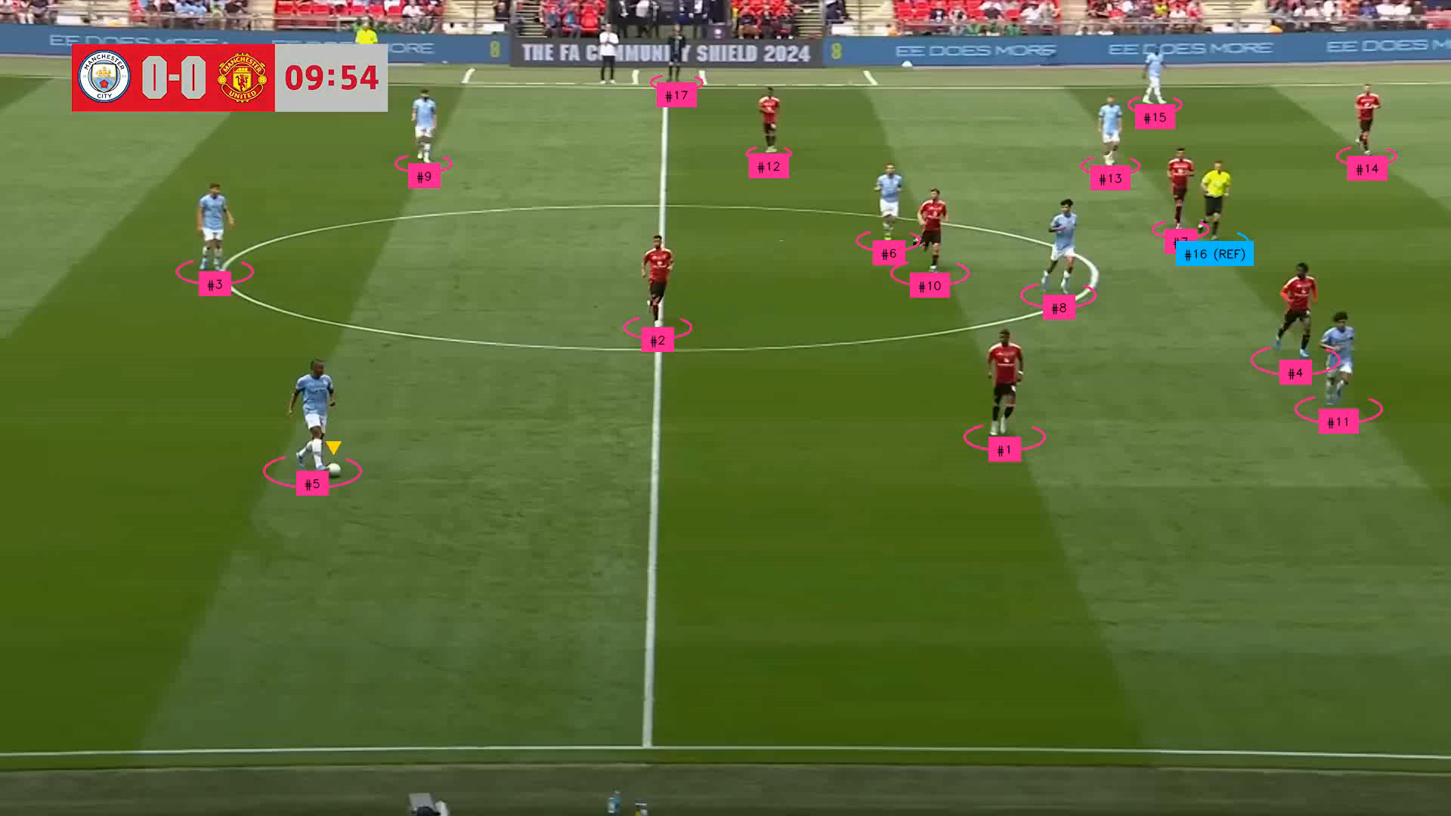
Jersey Identification

Slide 14
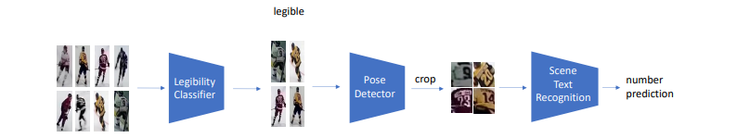
Jersey Identification
ResNet34 Classifier
ViTPose
parseq

Slide 15
Jersey Identification
ResNet34 Classifier
ViTPose
parseq
Problem?

Slide 16
Jersey Identification
Problem?
Only 45 unique numbers in the dataset!
Pose Detector consumes a lot of time

Slide 17
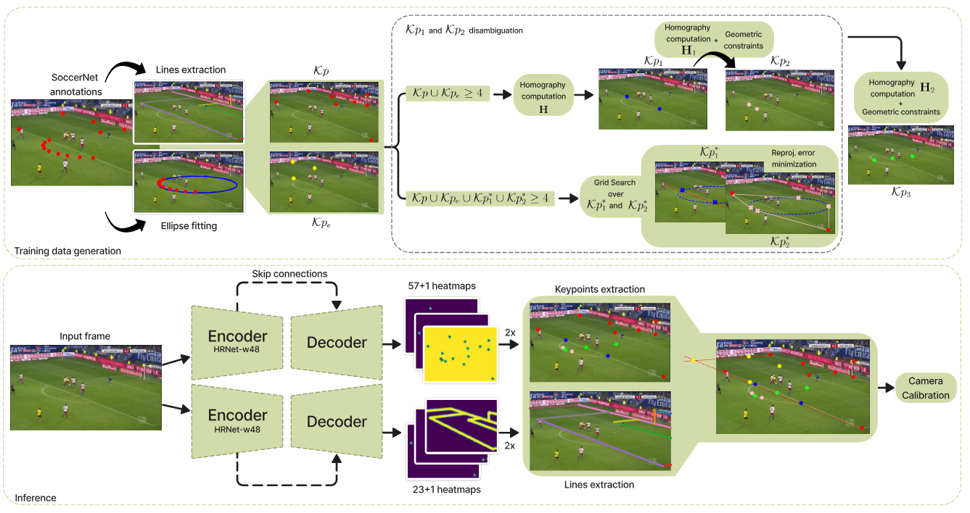
Calibration + 2D Transformations
For Calibrations, we use the model from No Bells Just Whistles. This model runs on a modified version of HRNet, it predicts the homography mapping from the Real World Co-ordinates to the Camera Co-ordinates.

Slide 18
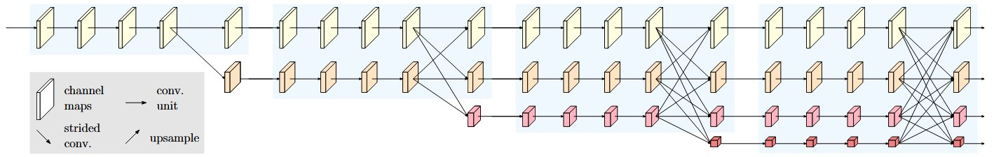
Calibration + 2D Transformations
HRNet Architecture:

Slide 19
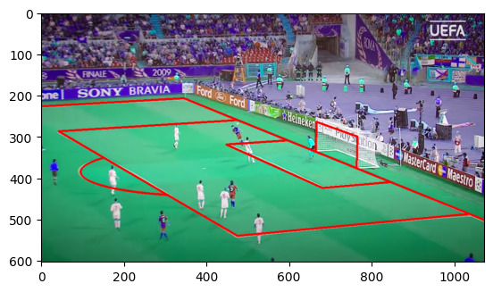
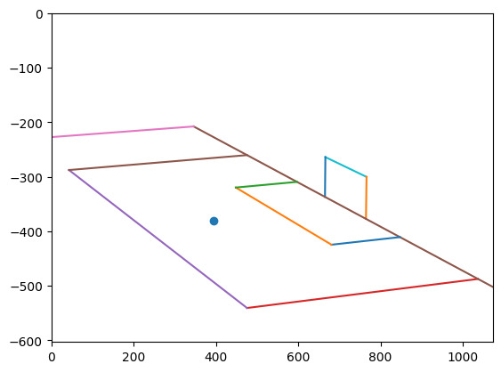
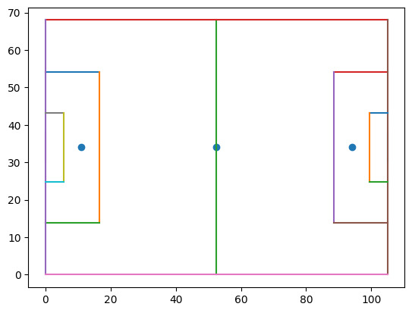
Calibration + 2D Transformations
Why No-Bells Just-Whistles? Uses two models for detection: Key points + Lines. Use a camera model to predict a projection matrix. But how to project?
P = K × R × [ I | - c]
Homogenous Coordinates:
[x y]^{T} —> [x y 1]^{T}
[a b c]^{T} —> [a b c 1]^{T}
Since all our points are on the ground, we can set c = 0, effectively reducing the matrix from 3x4 to 3x3
P_{reduced}[x y 1]^{T} = [a' b' c']^{T} —> [a b 1]^{T} (Divide by c')
Hence to revert this:
P⁻¹_{reduced}[a b 1]^{T} = [x' y' z']^{T} —> [x y 1]^{T} (Divide by z')

Slide 20

Calibration + 2D Transformations
We also use a weighted sliding window averaging model to reduce the noise/jitter in player positions. For ball detection, we use interpolation.
Frame position weightage:
Current frame: 28.57%
Adjacent frames: 21.42%
Two frames away: 14.28%

Slide 21
ANALYSIS AND VISUALISATION

Slide 22
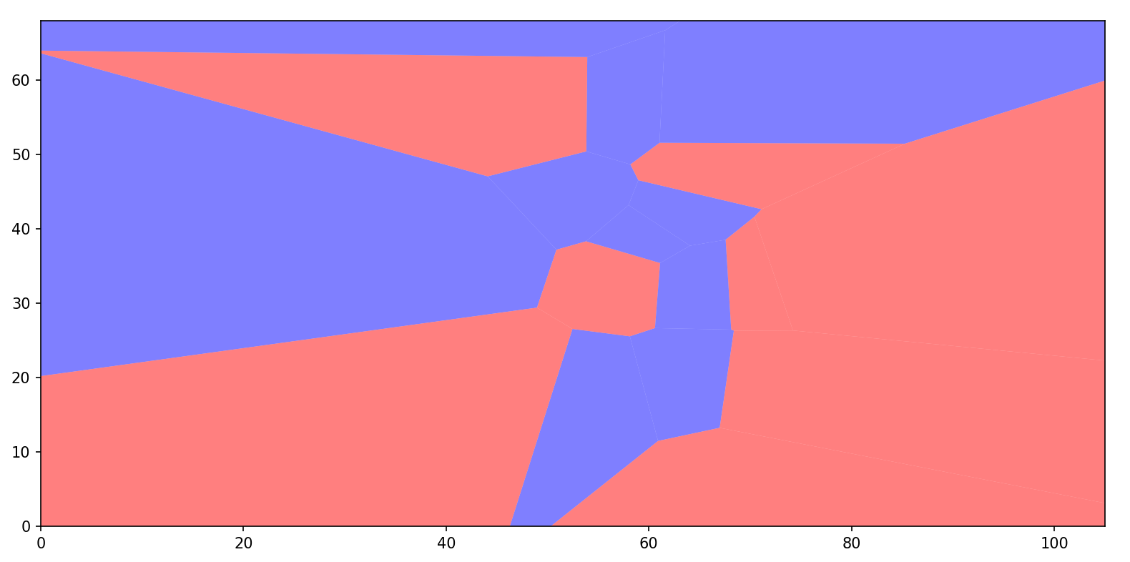
VORONOI DIAGRAM

Slide 23
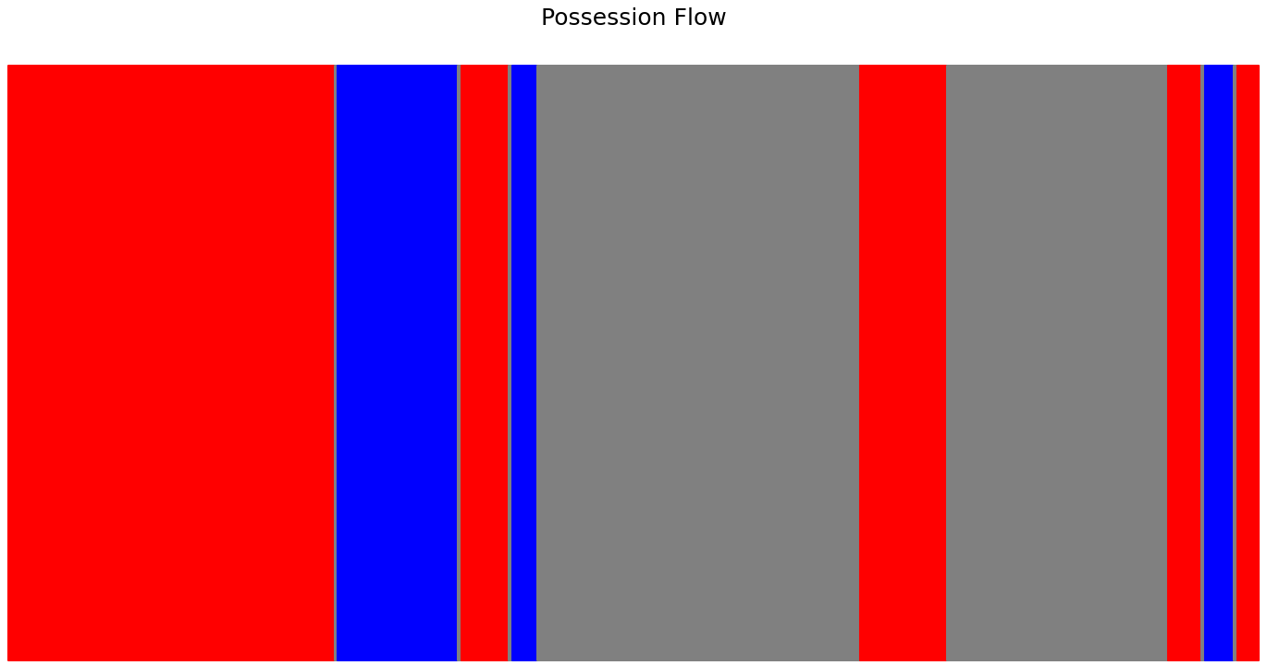
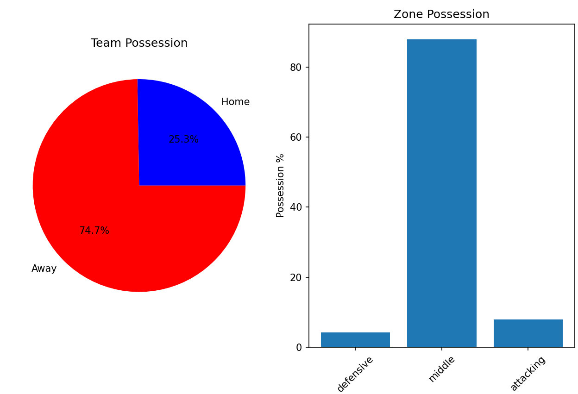
BALL STATISTICS

Slide 24
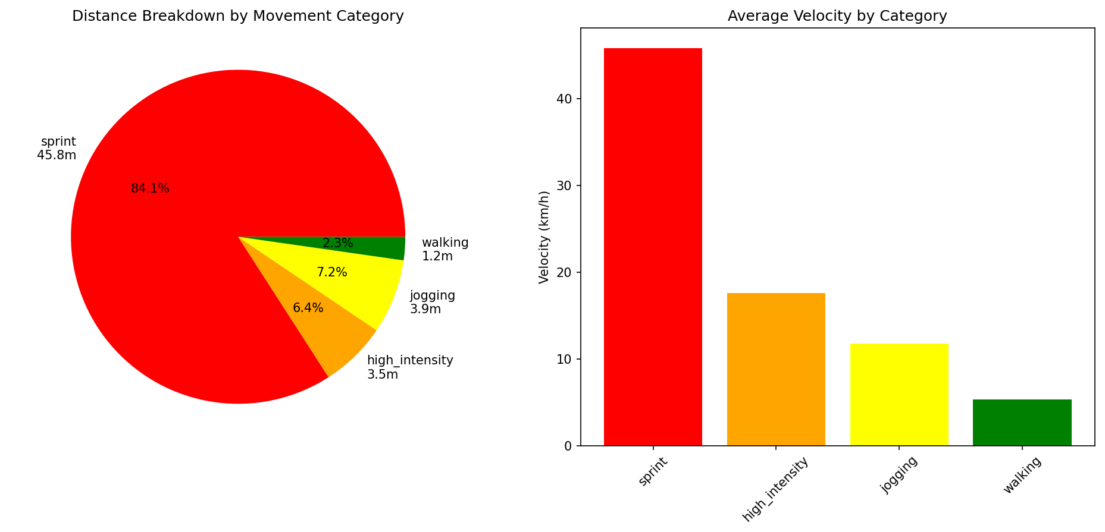
MOVEMENT ANALYSIS

Slide 25
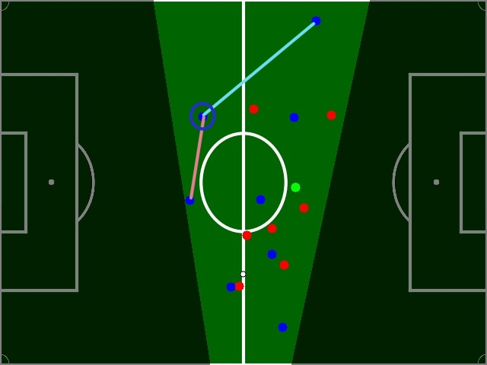
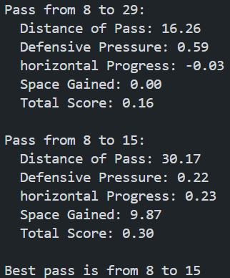
PASSING OPPORTUNITIES

Slide 26
UI and Design

Slide 27
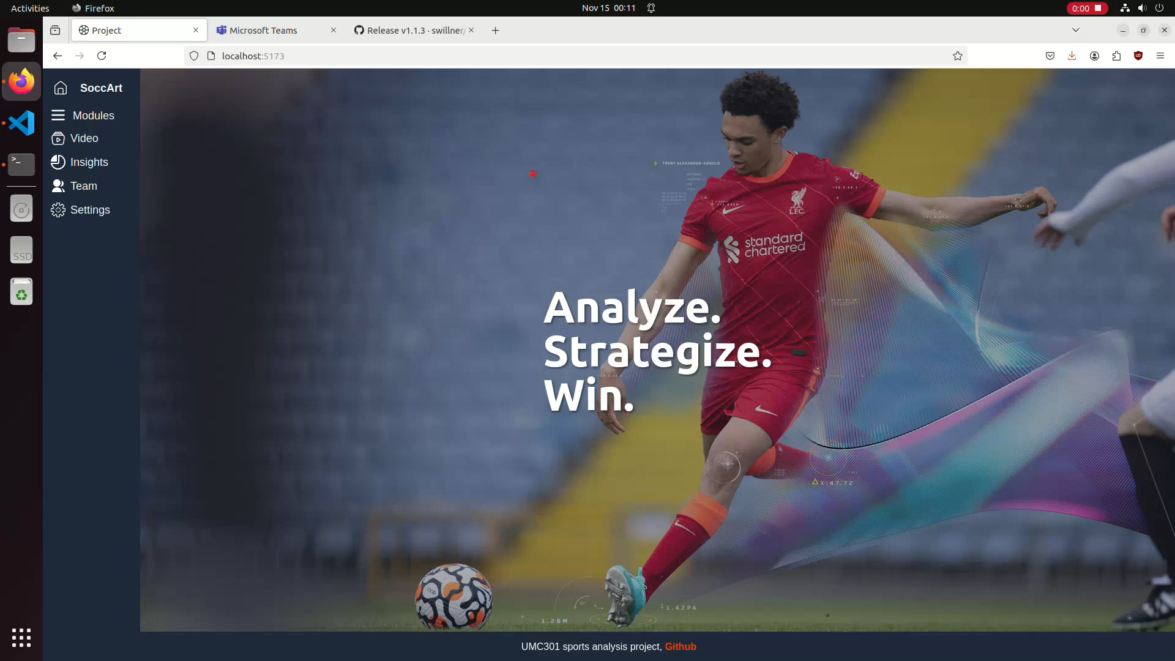

Slide 28
Challenges
Calibration State of the Art: Does not work from certain angles, zooms. There is a certain part of the pitch where neither half circles are visible, the model messes up here. State of the art models are also offline models. This means that live footage cannot be calibrated on.
Goalkeeper Team Identification: Certain documented edge cases will lead to misclassification of the goalkeeper's team
Ball Tracking: Very inaccurate. We had to interpolate for significant portions of the video.
Jersey Identification: Very accurate(87% on test dataset) but time consuming
Analytics: Many analysis metrics are hard to calculate as the video doesn’t cover the whole pitch.
Most "good looking"/"well performing" models seen online show their results on severely overfitted data. It looks good but is not reproducible

Slide 29
References
Finance
https://financefootball.com/2021/01/26/top-20-football-clubs-by-revenue-2021/
SoccerNet Game State Reconstruction
https://openaccess.thecvf.com/content/CVPR2024W/CVsports/papers/Somers_SoccerNet_Game_State_Reconstruction_End-to-End_Athlete_Tracking_and_Identification_on_CVPRW_2024_paper.pdf
No Bells Just Whistles
https://openaccess.thecvf.com/content/CVPR2024W/CVsports/papers/Gutierrez-Perez_No_Bells_Just_Whistles_Sports_Field_Registration_by_Leveraging_Geometric_CVPRW_2024_paper.pdf
TVCalib
https://openaccess.thecvf.com/content/WACV2023/papers/Theiner_TVCalib_Camera_Calibration_for_Sports_Field_Registration_in_Soccer_WACV_2023_paper.pdf
ByteTrack
https://www.ecva.net/papers/eccv_2022/papers_ECCV/papers/136820001.pdf
Jersey Recognition
https://openaccess.thecvf.com/content/CVPR2024W/CVsports/papers/Koshkina_A_General_Framework_for_Jersey_Number_Recognition_in_Sports_Video_CVPRW_2024_paper.pdf
HRNet
https://arxiv.org/pdf/1908.07919
ViTPose
https://arxiv.org/pdf/2204.12484
ResNet
https://arxiv.org/pdf/1512.03385

Slide 30
Individual Contributions
Aditya: Player Tracking, Backend Integration
Armaan: Key point detection, 2-D projection
Sahil: Ball Tracking, JN Identification, UI
Sharath: Analytics, Frontend Development
Shishir: Analytics, Visualization modules
Umang: Literature Review, Map Calibration
J Rishi: Mentor, Emotional Support
View the code at https://github.com/adityapgupta/Sports-Analysis

